Slide 1
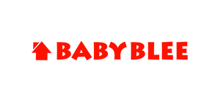
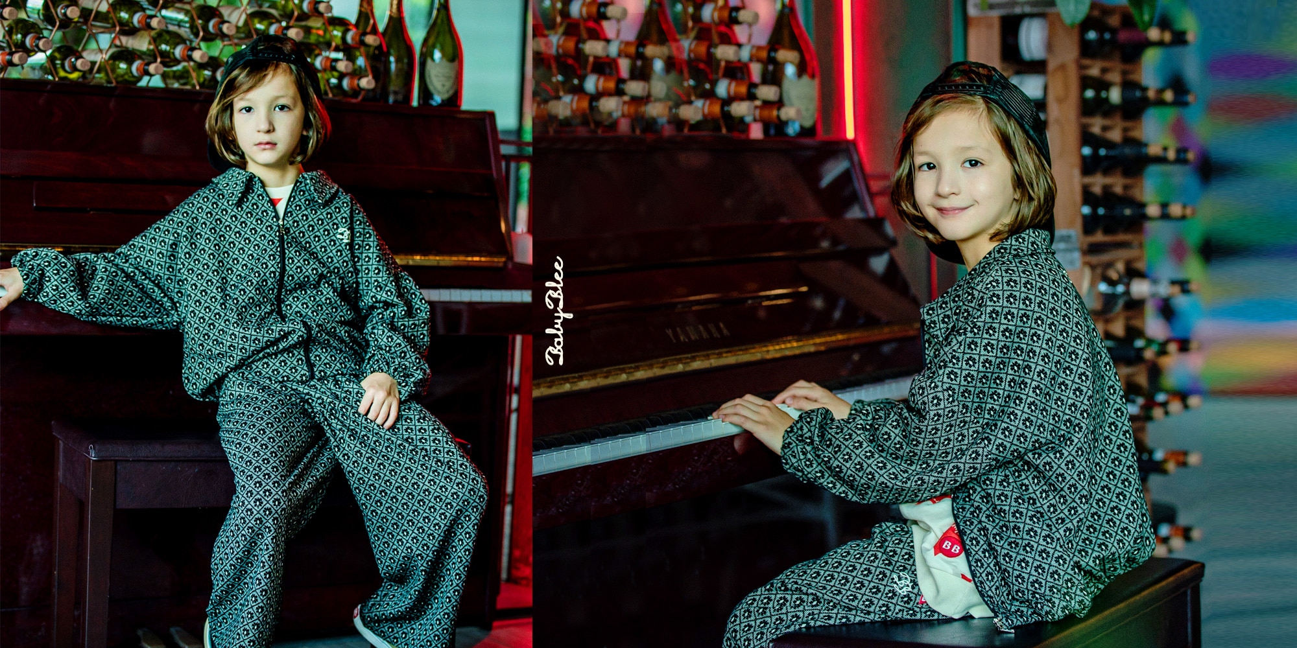
Babybly - Fashion for babies and toddlers

Slide 2

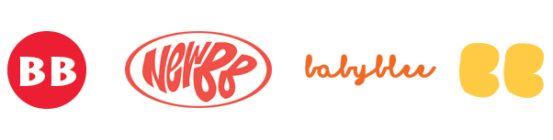
Babyblee is a high-quality fashion brand for babies and toddlers, offering trendy designs and comfort.
회사 소개
About us
BabyBlee wears a sensational trend. A unique casual look.
The materials, colors, and artwork are seasonally appropriate, reflecting the latest trends and capturing the cuteness of Babyblee.
BabyBlee
For BabyBlee, the house shape in the logo means [ space=brand ], and + Baby [ baby, child ] + Blee [ bright + love + everlasting ] means [ bright, love, everlasting ], which is a brand that shines brightly and lovingly for a child forever.
2024 LOOK BOOK : Youtube video
part 1 : https://youtu.be/jxKIcDUwOAA
part 2 : https://youtu.be/2lSkJdmo3C4

Slide 3
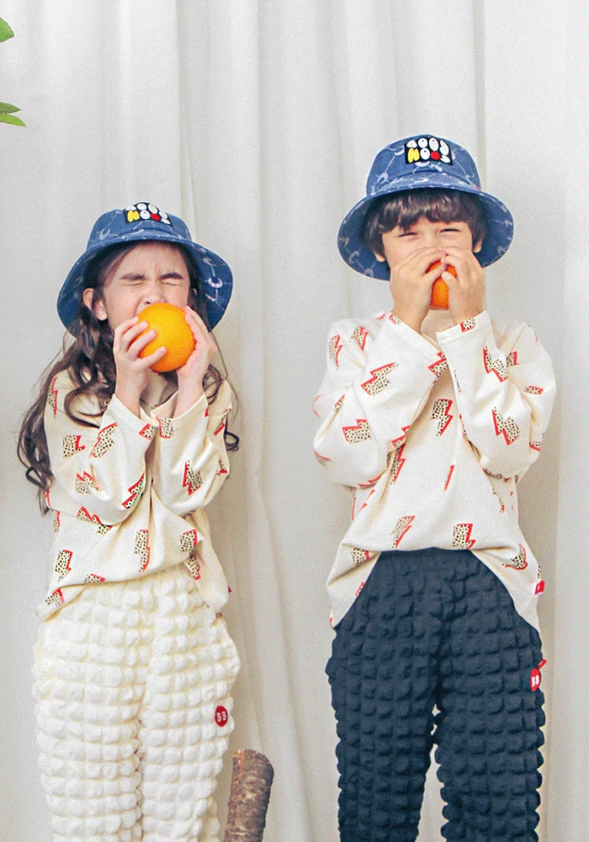
VISION of BABYBLEE
Our designs are divided into two styles: "Brown Label", which reflects a popular and trendy feel, and "Red Label", which is represented by original artwork. Both styles combine cuteness and comfortable materials to create a sensible and trendy design.
The LOGO stands for an eternally shining and loving brand for our children, so we are striving to make honest and better products for children with a heart that is true to the basics. We will develop into a brand that can increase value and trust, a design made with passion and know-how, and a brand that all customers can share with satisfaction. Thank you.
Babyblee is a high-quality fashion brand for babies and toddlers, offering trendy designs and comfort."
BABYBLEE

Slide 4
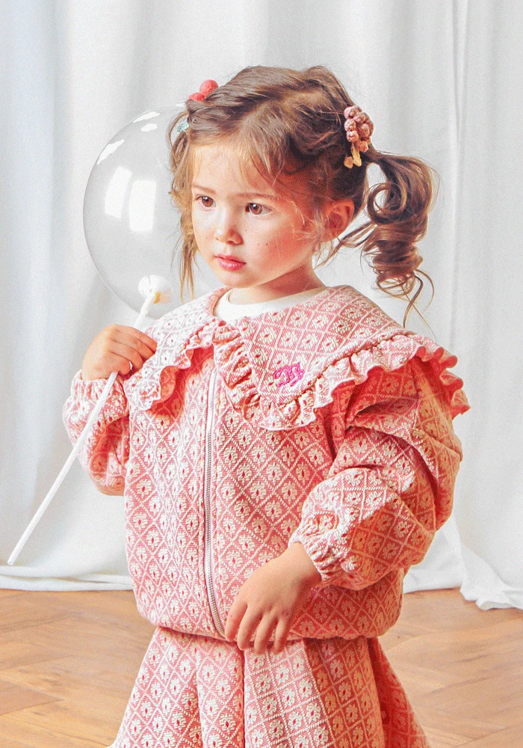
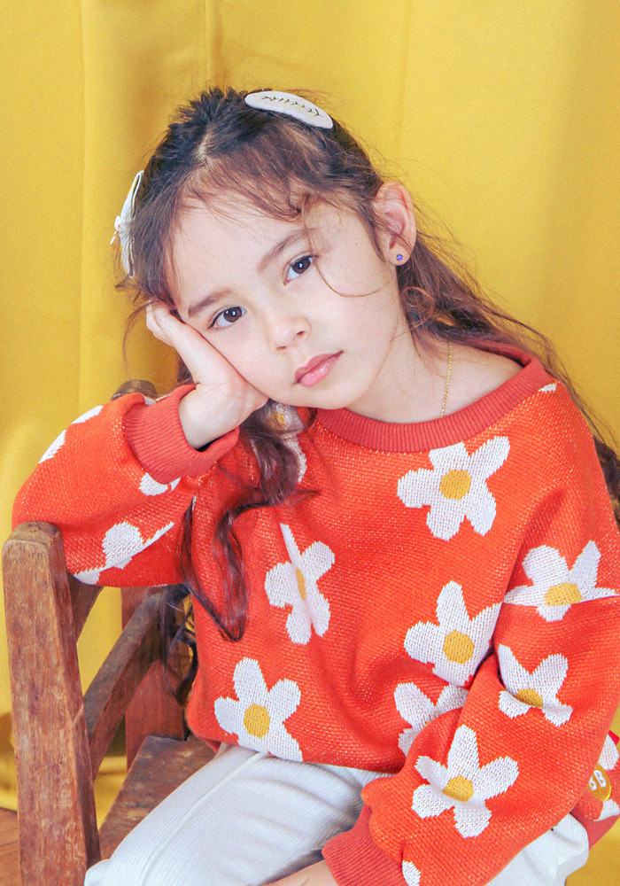
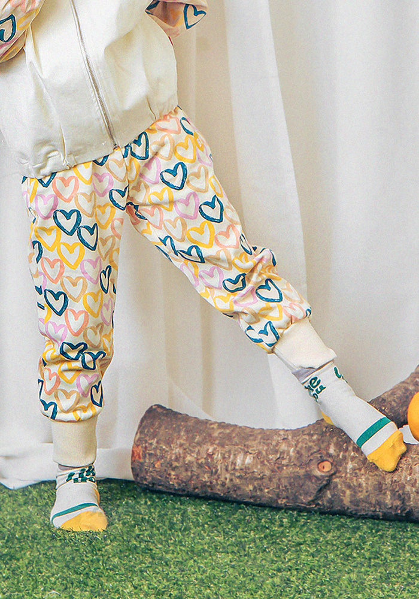
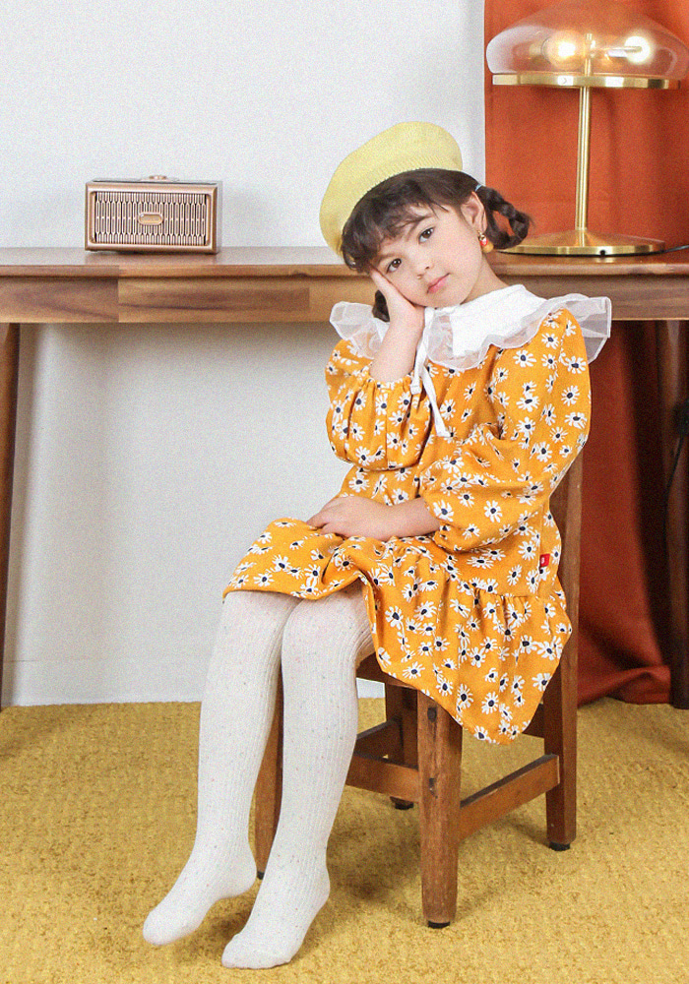
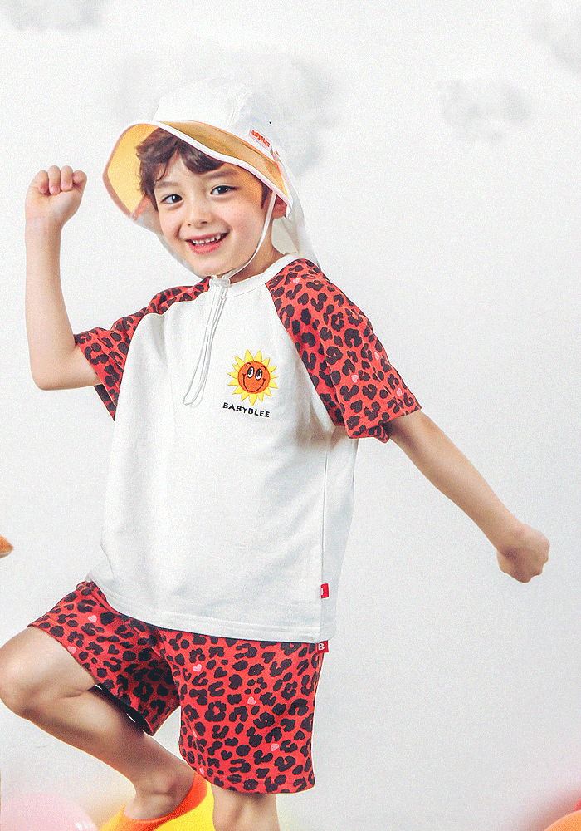
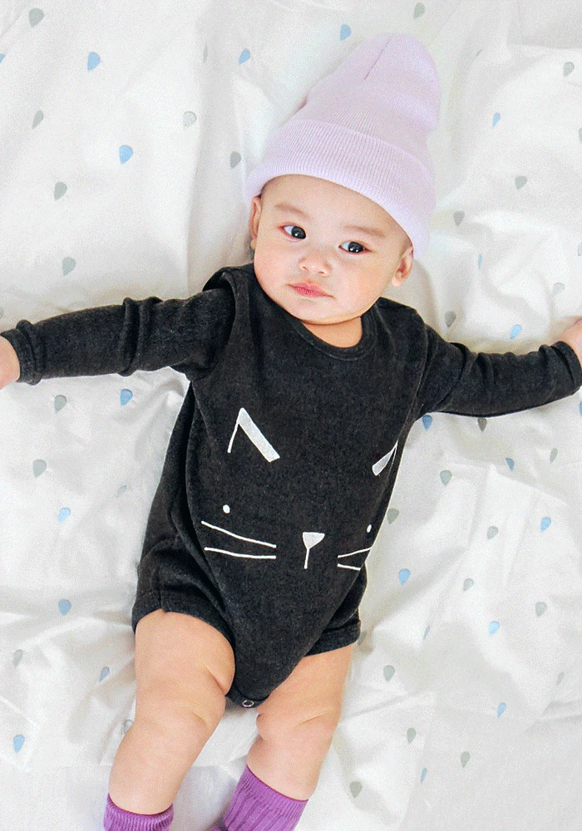
Product lineup
Outerwear
Top
Bottoms
One piece
Set product
Baby clothes
BABYBLEE

Slide 5
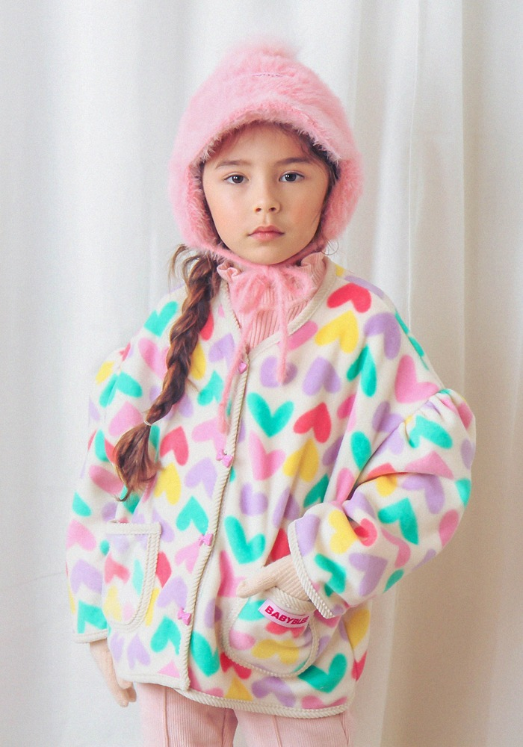
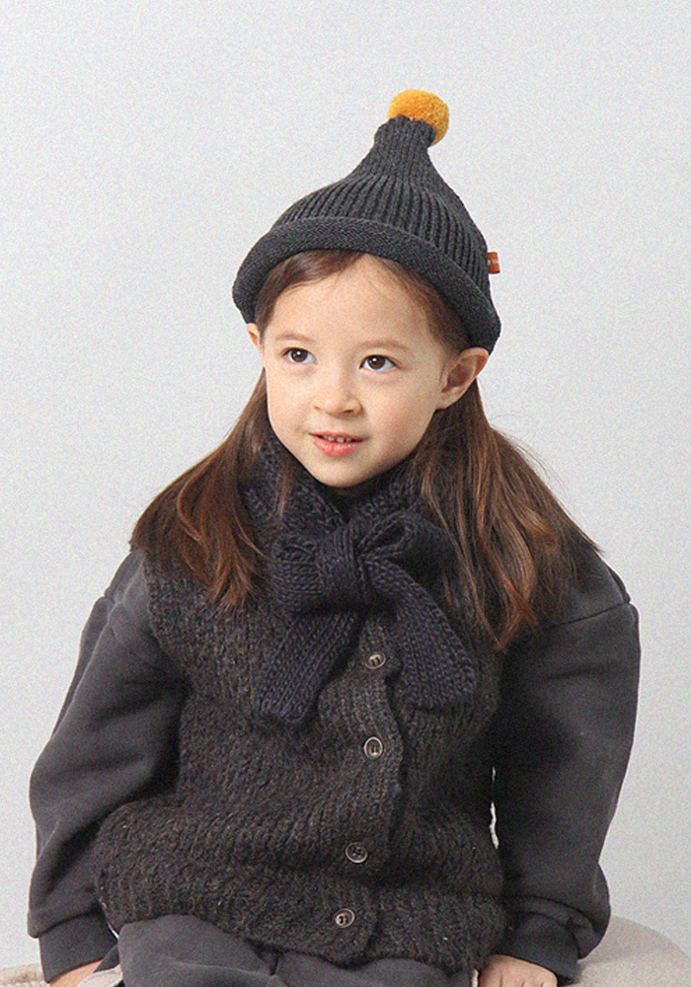
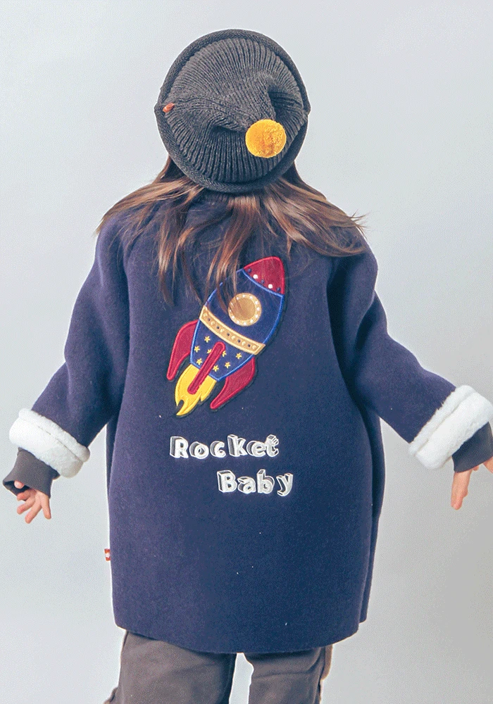
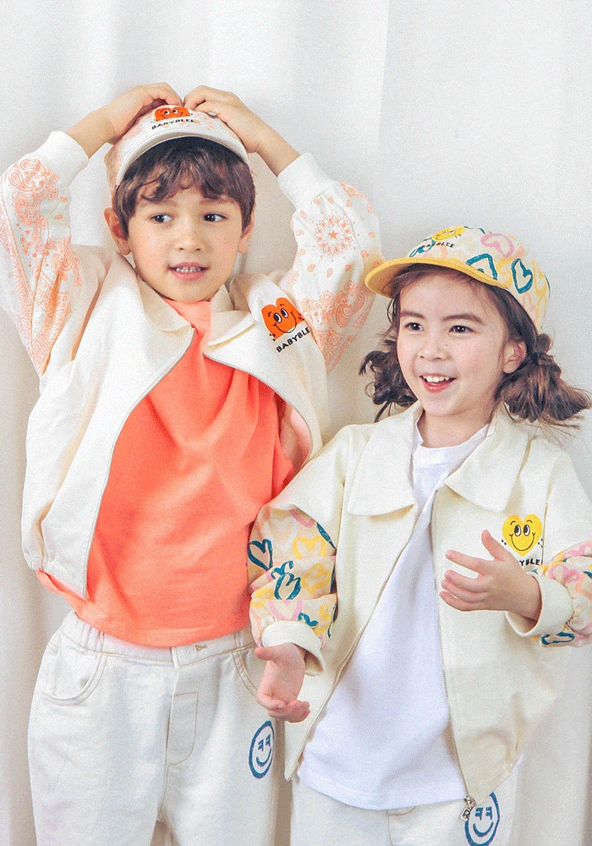
Outerwear
Stylish and warm outerwear
BABYBLEE

Slide 6
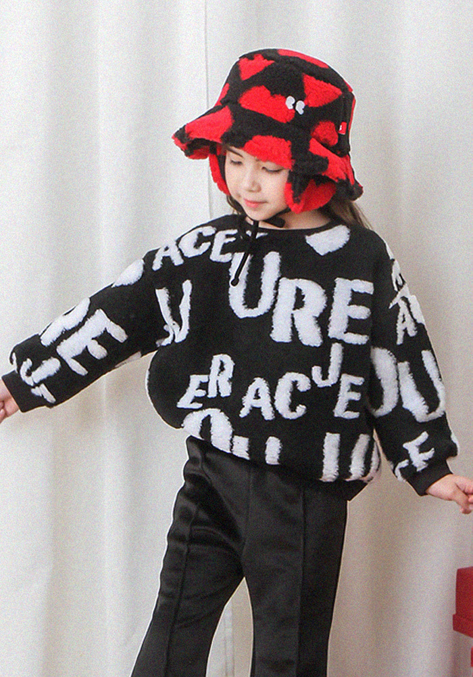
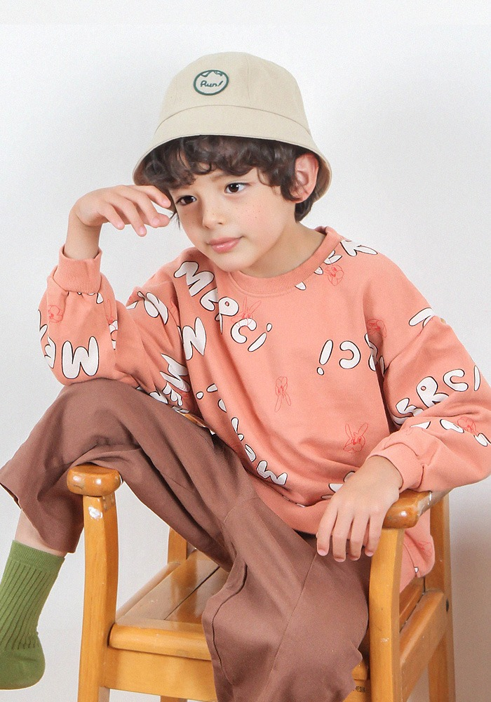
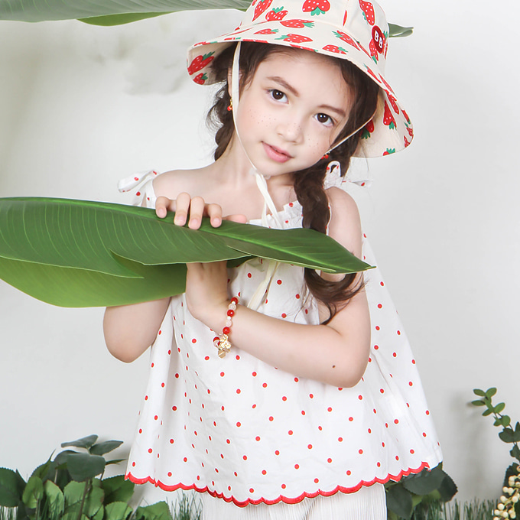
Top
Tops that combine fresh design with comfort
BABYBLEE

Slide 7
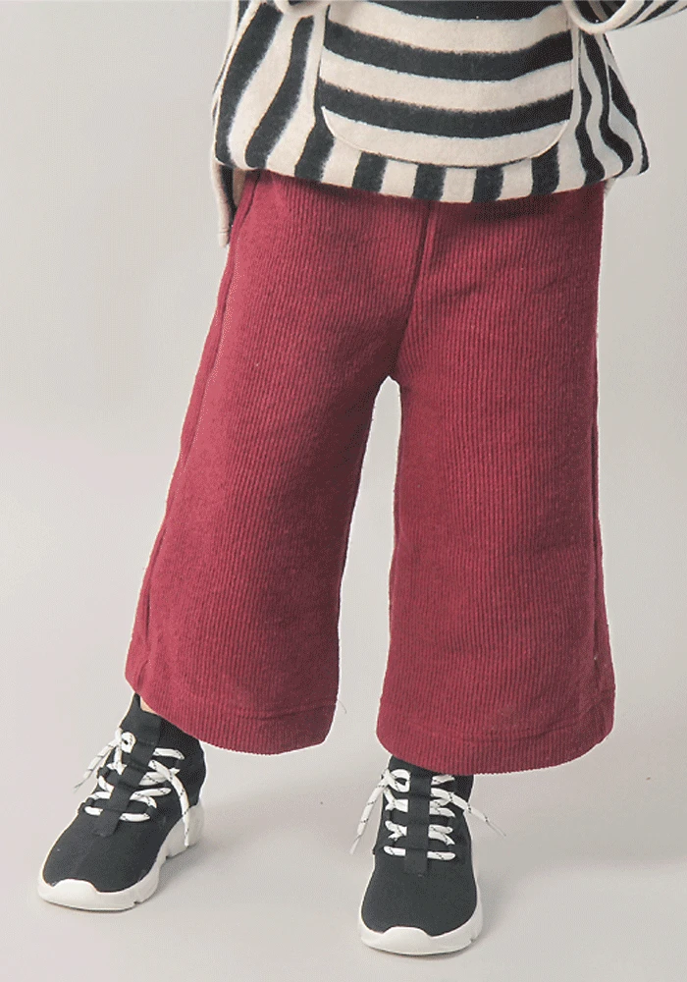
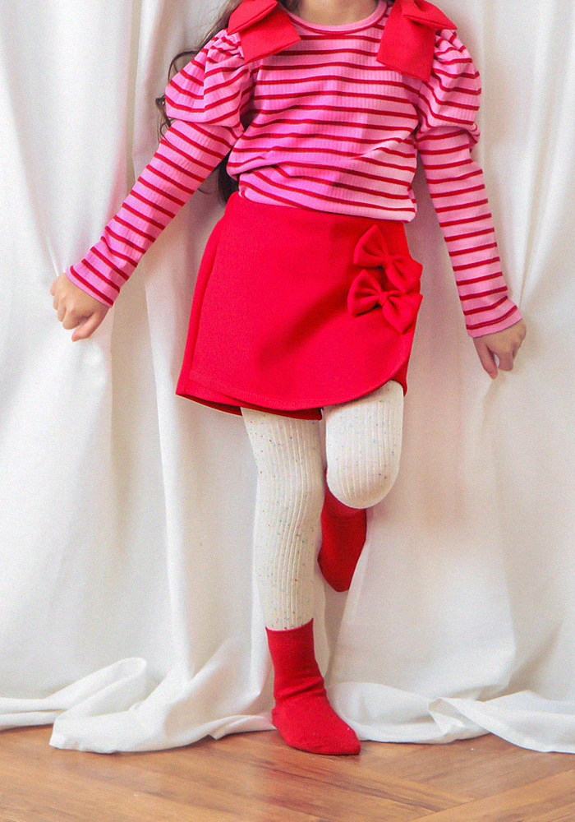
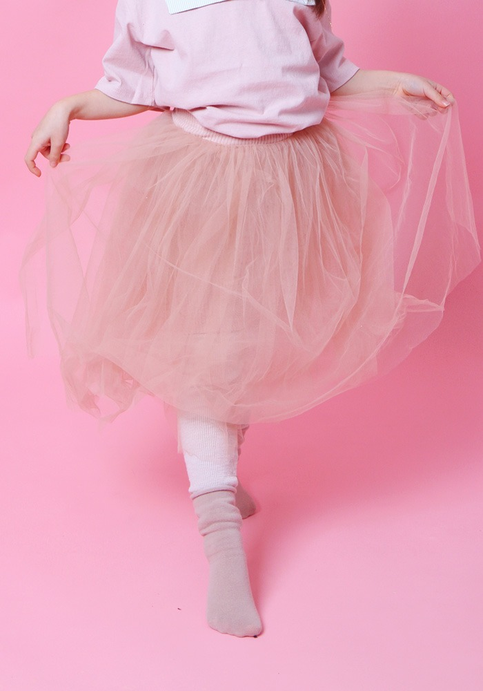
Bottoms
Comfortable bottoms for active babies
BABYBLEE

Slide 8
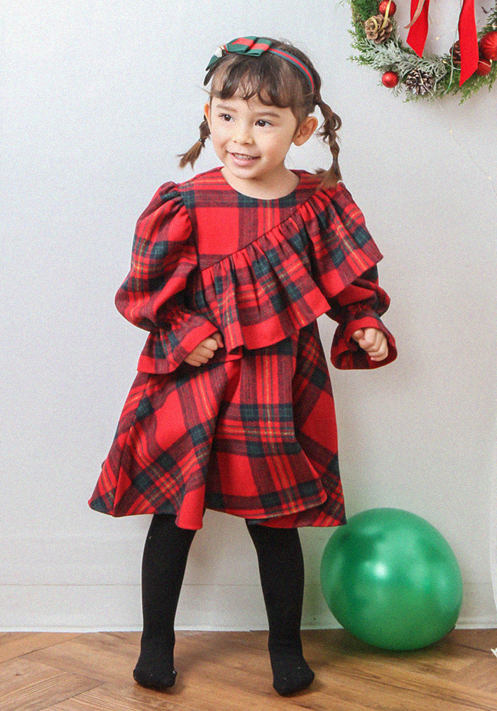
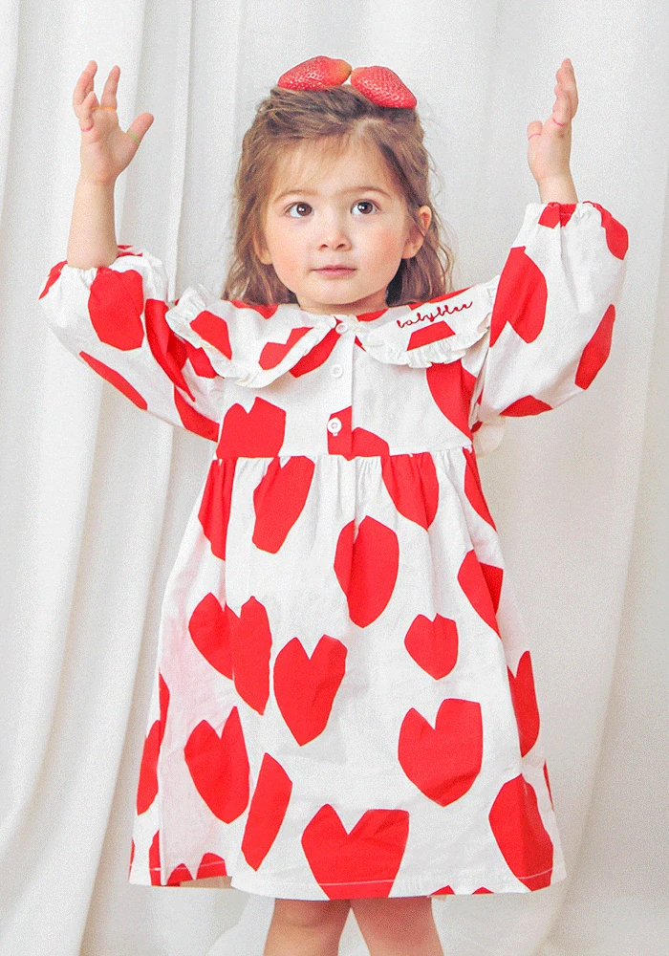
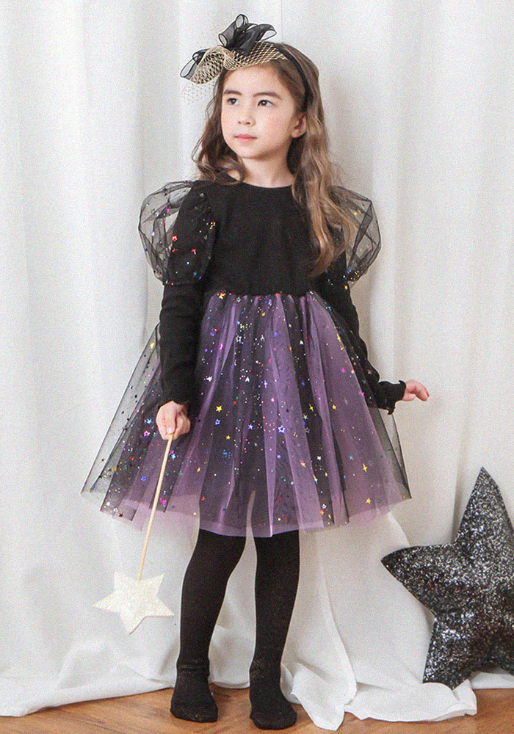
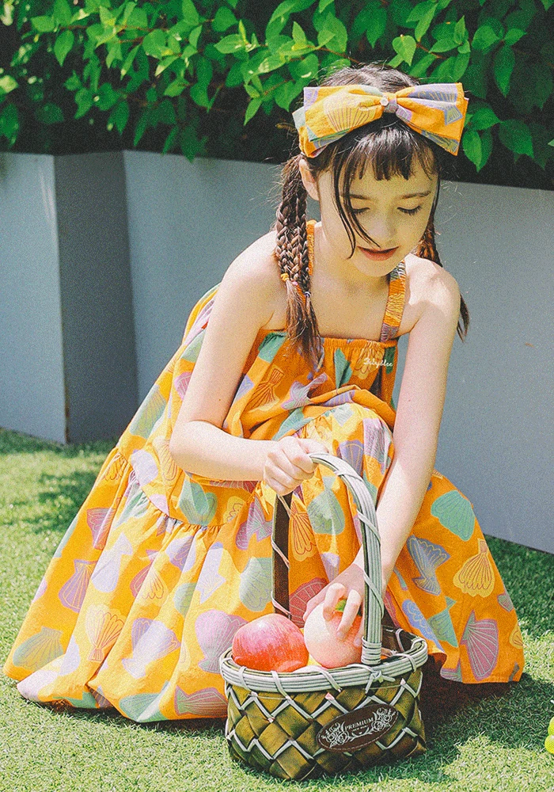
One piece
Stylish dresses
BABYBLEE

Slide 9
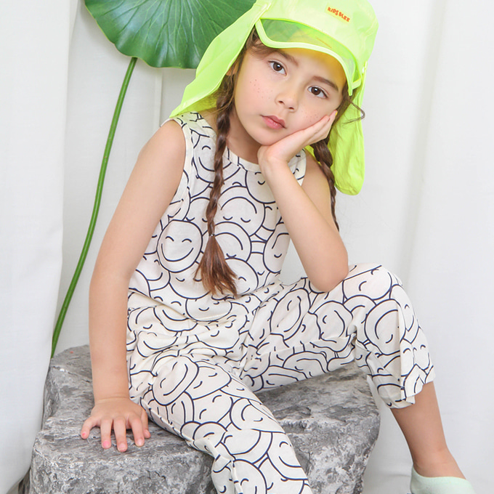
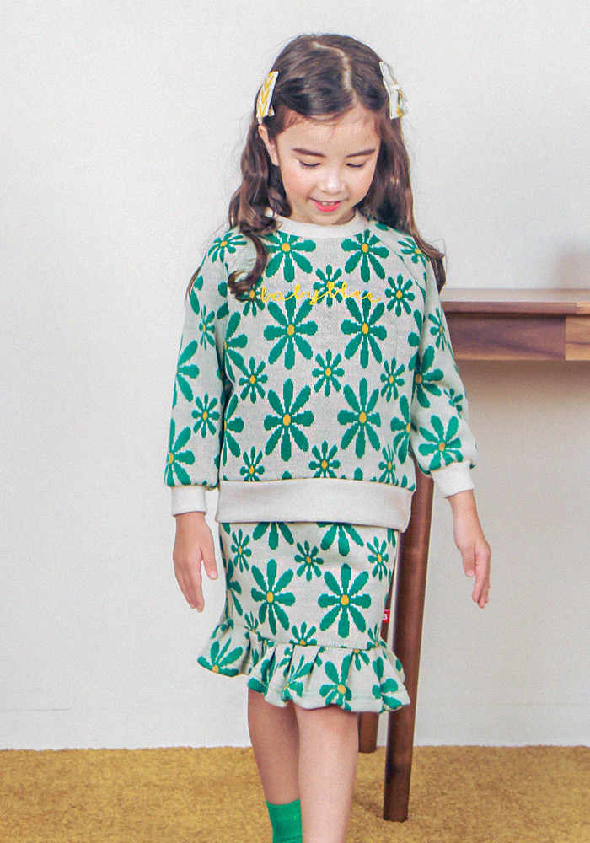
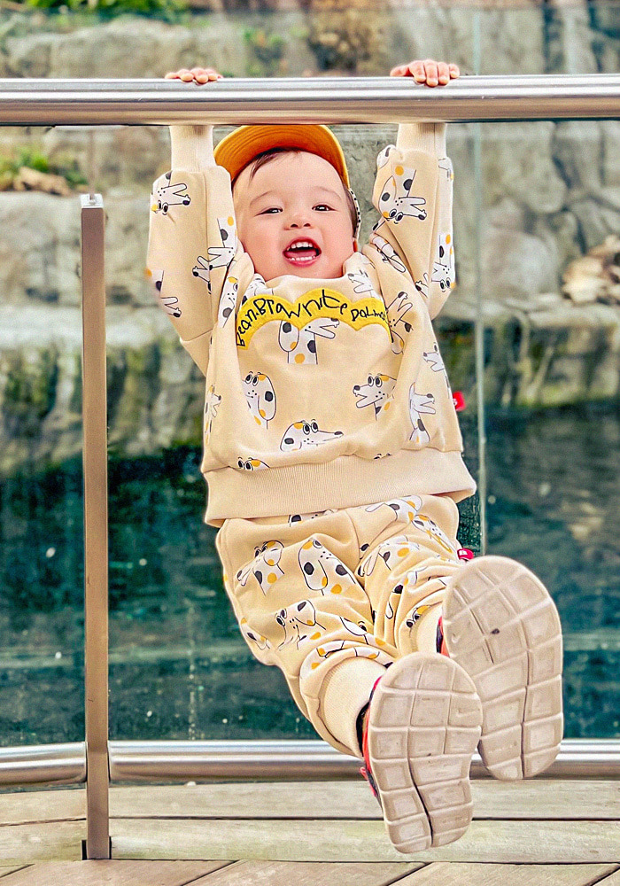
Set Product
Practical set products
BABYBLEE

Slide 10
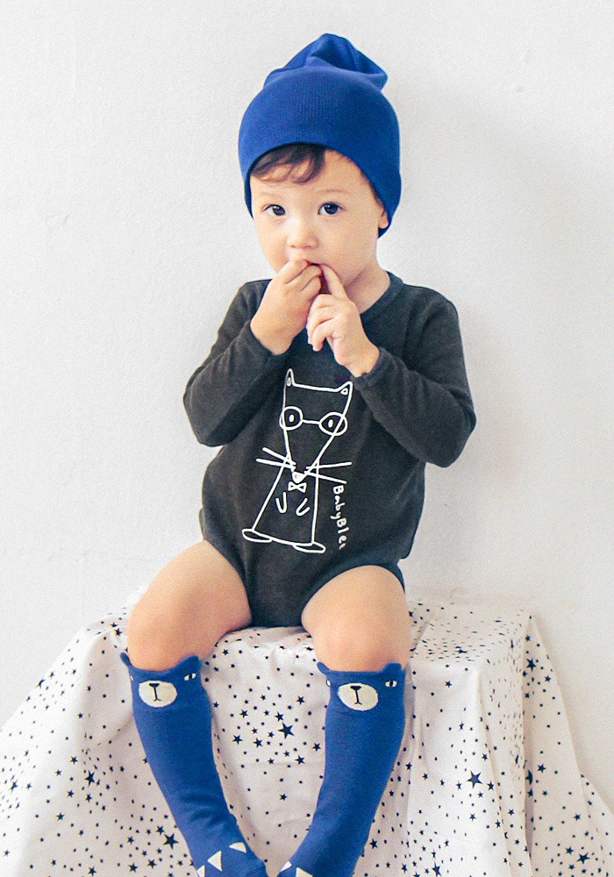
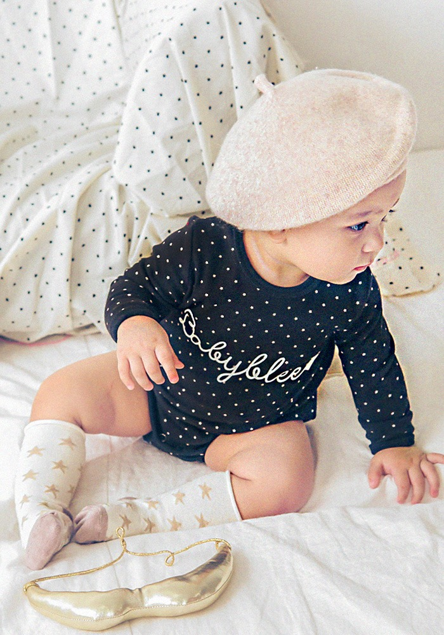
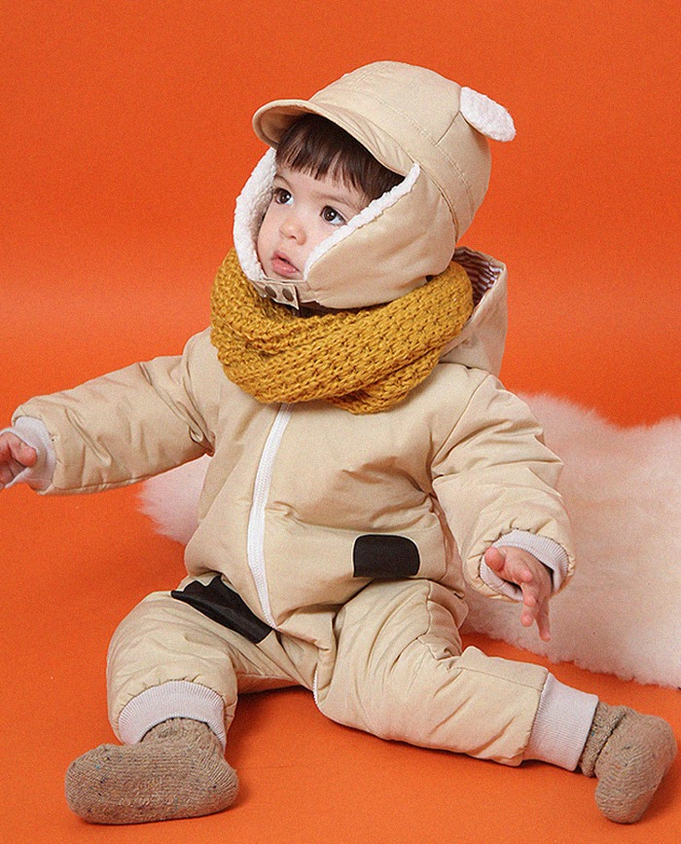
Baby clothes
Gentle, safe products for newborns and babies
BABYBLEE

Slide 11
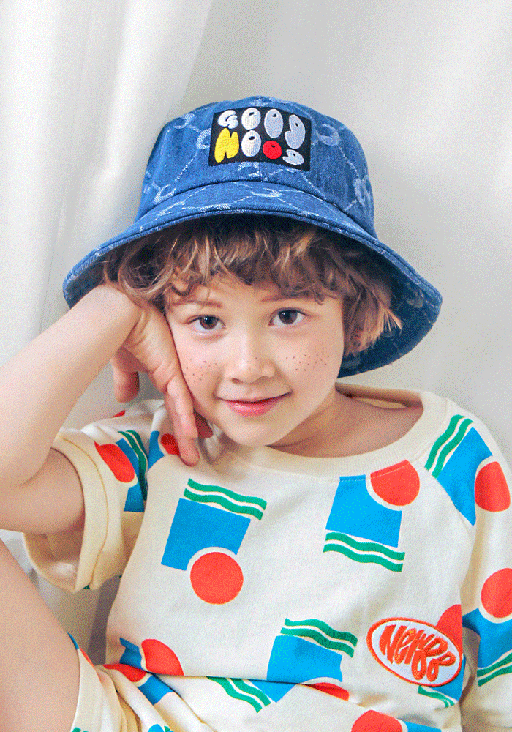
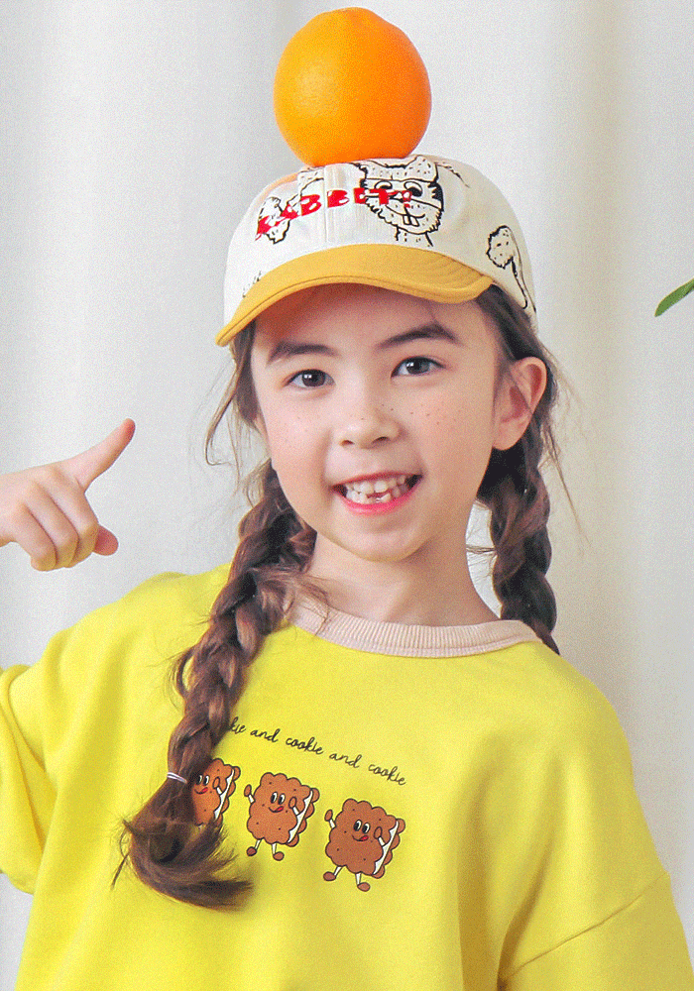
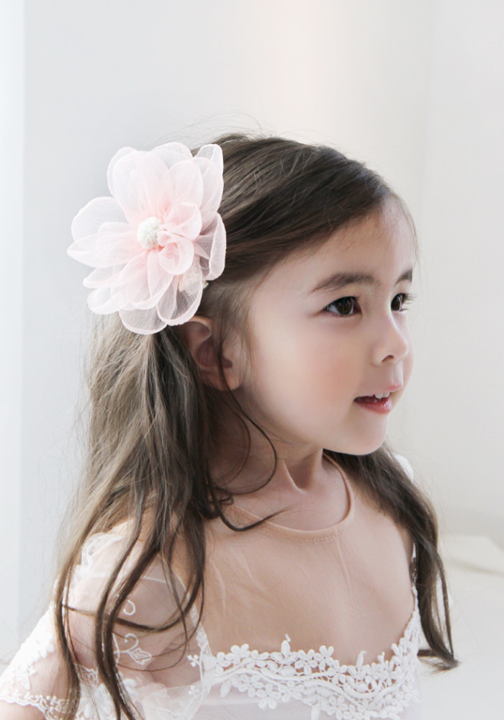
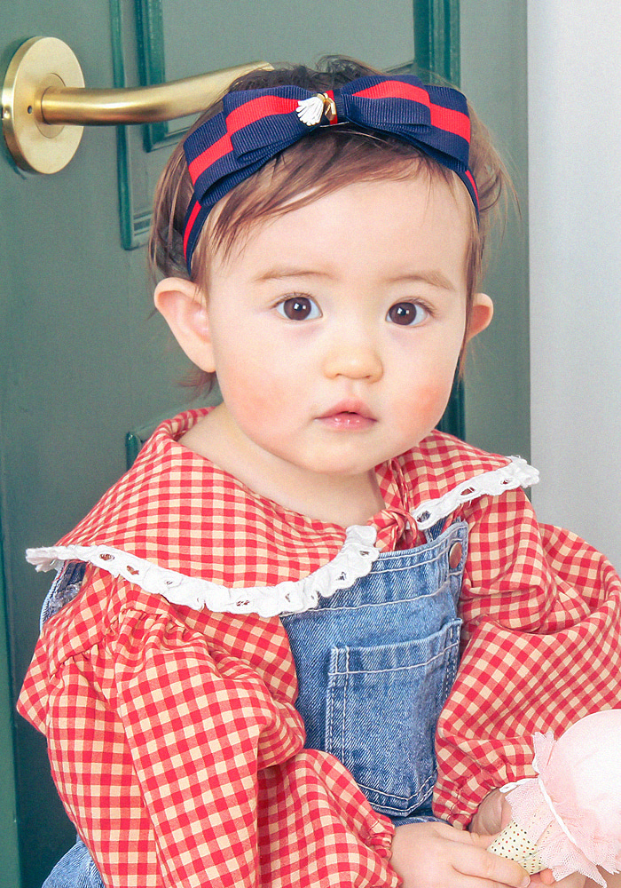
Coordinating items
Complete your look with Babyblee's many coordinating items
BABYBLEE

Slide 12
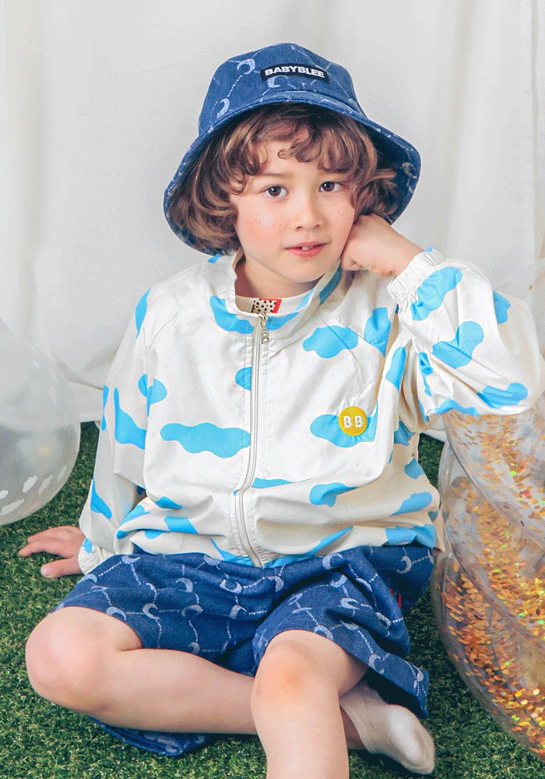
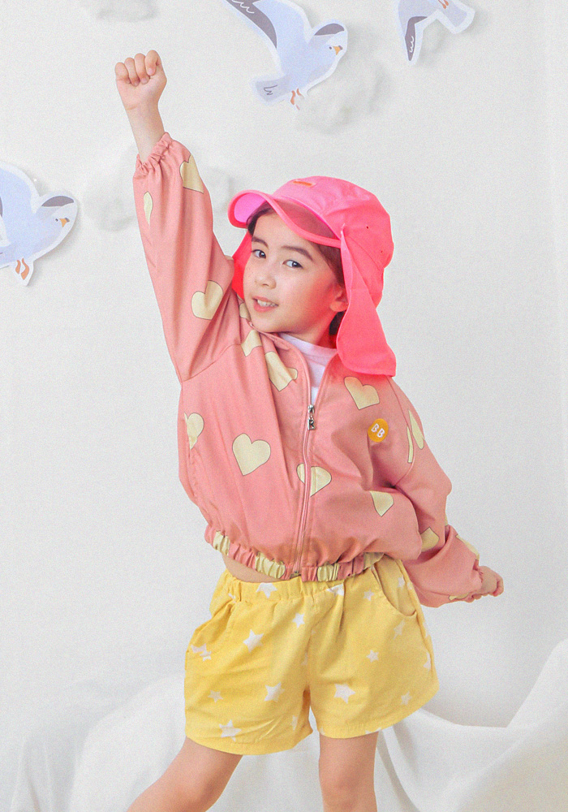
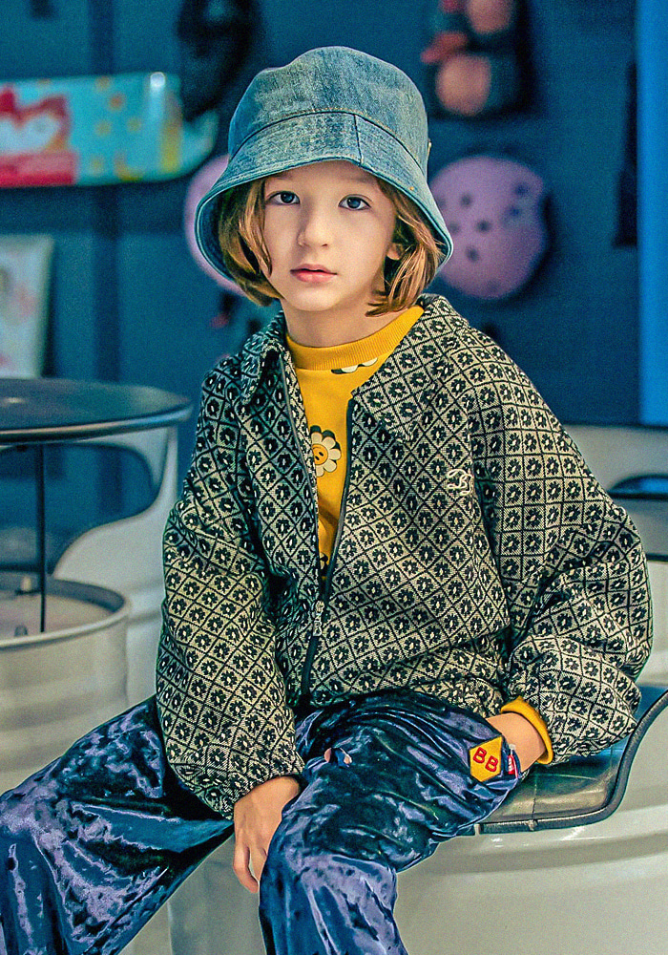
Latest Collections
Discover Babyblee's latest collection!
BABYBLEE

Slide 13
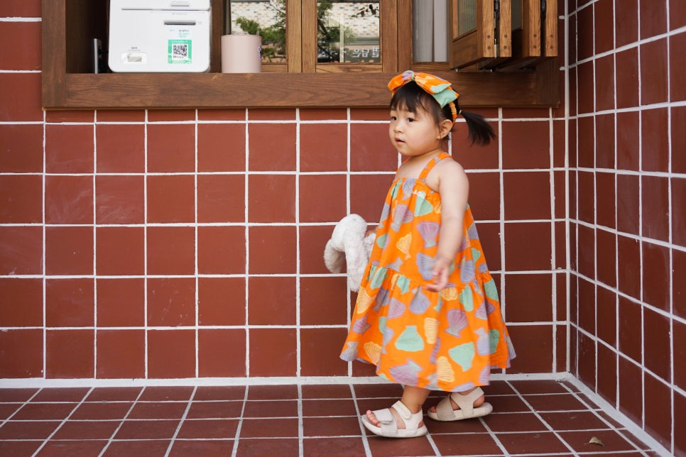
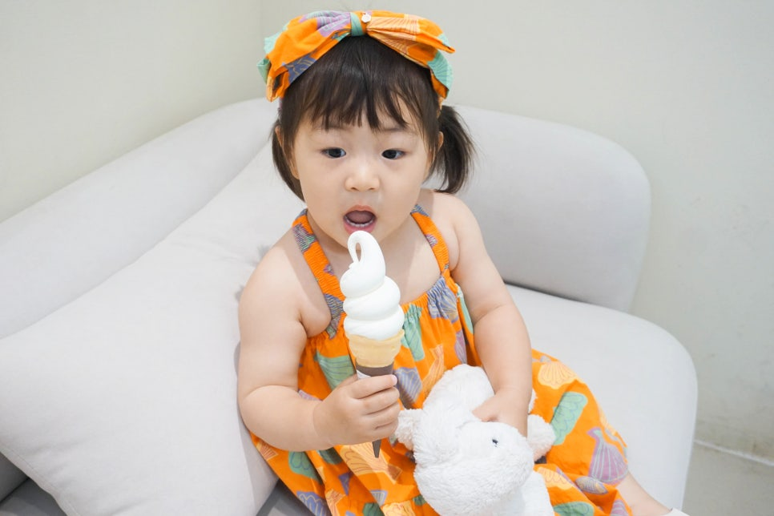
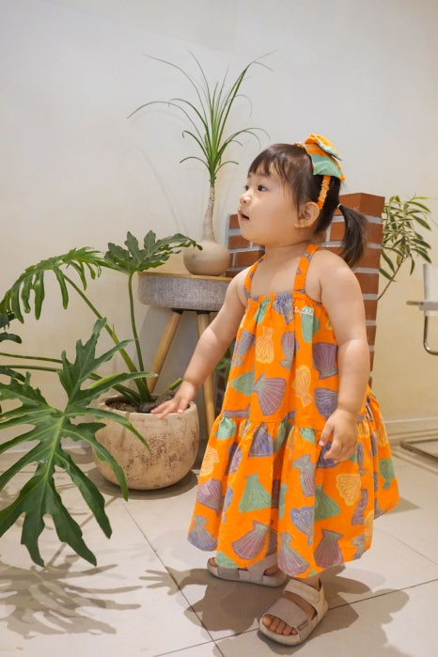
Customer reviews
What customers are saying about Babyblee?
고객 1:
프리미엄 유니크 캐주얼 아기옷브랜드 베이비블리는 자체개발한 일러스트 제품들이 많아서 다른 유아옷에서 보지 못한 디자인이 많아서 좋았어요. 감도있는 디자인을 보여주고 있으며 아이들 악세서리인 모자, 헤어핀 등등 다양한 아이템들도 함께 판매하고 있어요.
베이비블리는 디자이너 손을 거쳐 제작되어 완성도가 높은 키즈브랜드 입니다.
베이비블리 안에서도 대중성이 높은 브라운라벨과 유니크하고 스케치한 일러스트 아트로 나눠져 있어 다양한 컨셉으로 골라 쇼핑할 수 있어요~--
고객2:
유니크한 아기옷브랜드 베이비블리.
감각적이고 트렌디한 디자인이 많은데다 남아/여아 옷 모두 예뻐서 남매룩, 형제룩, 트윈룩으로도 인기가 많더라고요.
부담없이 데일리하게 활용하기좋은 캐주얼룩이면서도 우리 아이의 개성을 살릴 수 있는 디자인 덕분에 어린이집 등원룩, 문화센터룩으로도 아주 굳:)
많은 제품 중에서도 제 눈에 쏙 들어온 유아상하복!
호두는 피부가 뽀얀 편의 남자아기라 따뜻하고 밝은 톤에 레드 포인트가 더해진 이 아기상하복이 정말 잘 어울릴 것 같았거든요.
BABYBLEE

Slide 14
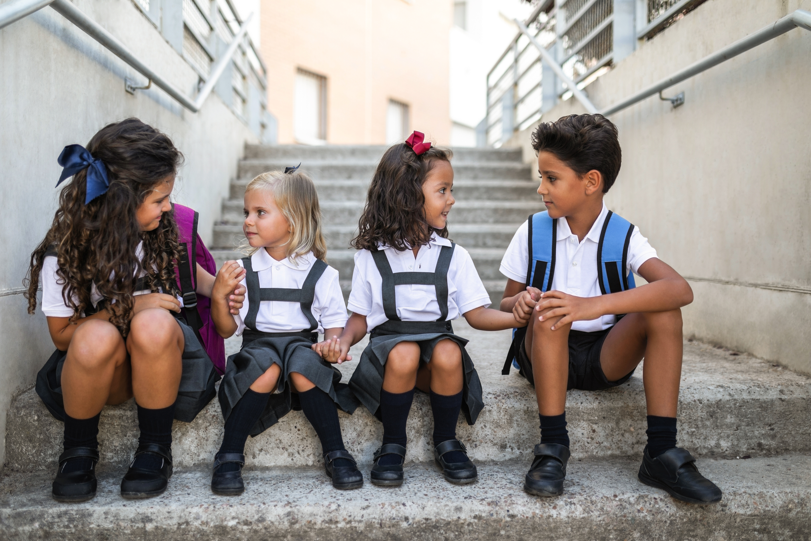
Contact
Company Name: New BB corporation
CEO of Newbee Corporation: Kim Taek Geum
Business Registration Number: 568-86-03190
Address: 202, 2F, 243, Samsong-ro, Deokyang-gu, Goyang-si, Gyeonggi-do, Republic of Korea (Zip Code: 10583)
Email: newbbofficial@naver.com
Contact Us: [Customer Service Information]"
Call center: 070-7753-6098 [Babyblee Headquarters]
MON ~ FRI 10:00 ~ 17:00
LUNCH TIME 12:30 ~ 13:30
SAT. SUN. HOLIDAY OFF
BABYBLEE

